Slide 1

Lignin biotechnology
Notes:
Good morning
Thank you for the invitation
Talk about fungal enzymes active towards lignocellulose
Short introduction to and then otherwise stay close to some of the research that I have been doing, and use these as examples of how we study fungal enzymes.
I am associate prof. here at DTU Bioengineering and I have worked with enzymatic conversion of lignocellulose for the past 15 years or so.

Slide 2
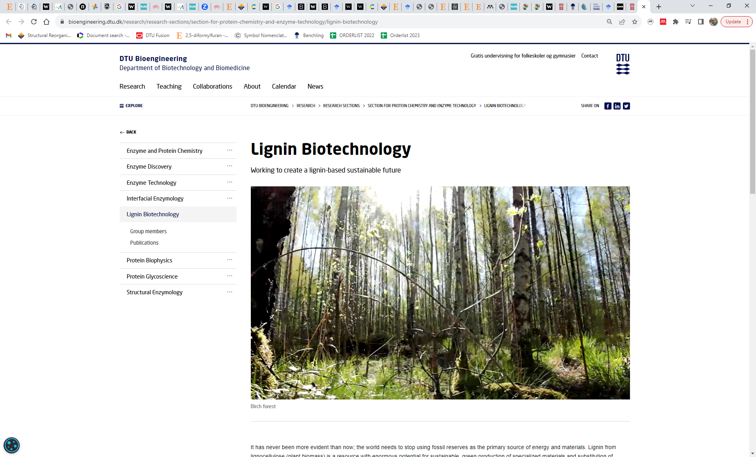
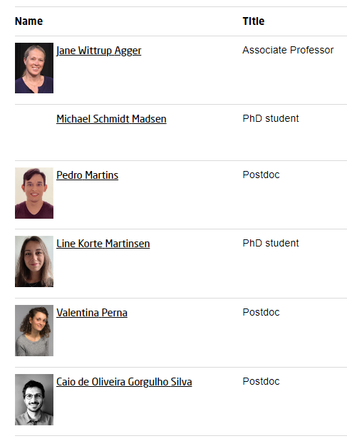

Slide 3
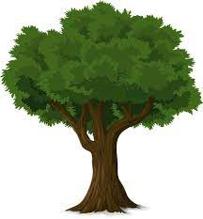
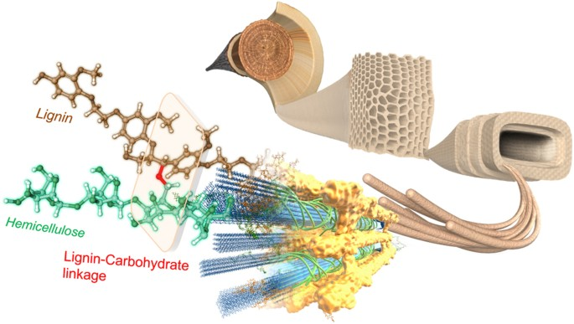




Lignocellulose
10¹¹ tons/year
Notes:
Lignocellulose is the non-edible parts of terrestrial plant biomass
It consists mainly of three different polymers, cellulose, hemicellulose and lignin.
The three-dimensional organization as we believe it is shown here.
Tightly bound in a network that creates strength for the plant. Consider that a tree stem has to be able to stand up straight, also when the wind blows.
Microbial attack, water transportation, large flexibility.
Lignocellulose is interesting in the context of a biobased and sustainable future society, because it is a truly renewable resource. 1011 tonnes of lignocellulose is produced every year! Also a great way to fix carbon dioxide.
So considering lignocellulose as a resource actually supports several of the UN SDGs about developing our society into a more sustainable one with focus on these four in particular.

Slide 4
Lignin
Oxidative radical coupling
p-coumaryl-
coniferyl-
sinapyl-alcohol
Ralph et al., 2004 Phytochem review 3, 29-60
Boerjan et al., 2003 Ann Rev Plant Biol 54, 519-546
p-Hydroxyphenyl
Guaiacyl
Syringyl
4

Slide 5
Lignin inter unit-linkages
β-1’
β-O-4’
β-β’ pironesol
β-5’ phenylcoumaran
4-O-5’
5-5’ biphenyl
5

Slide 6
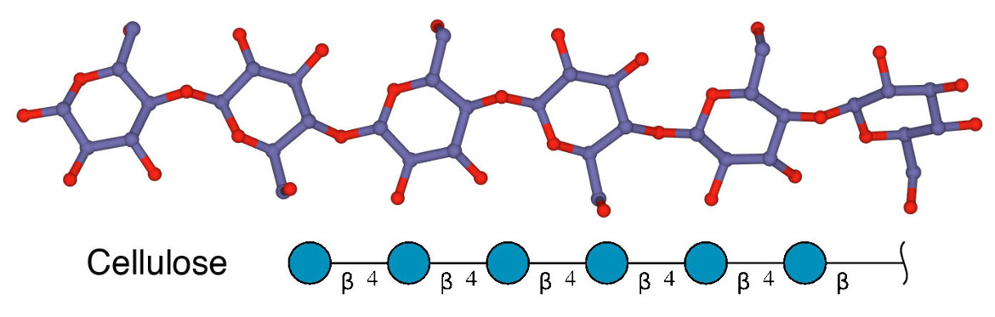
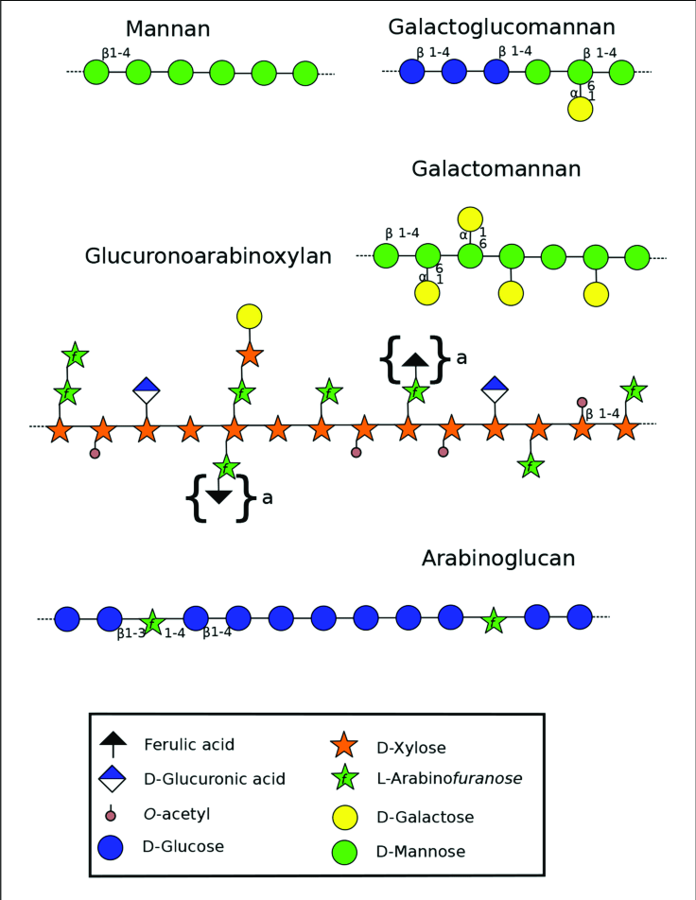
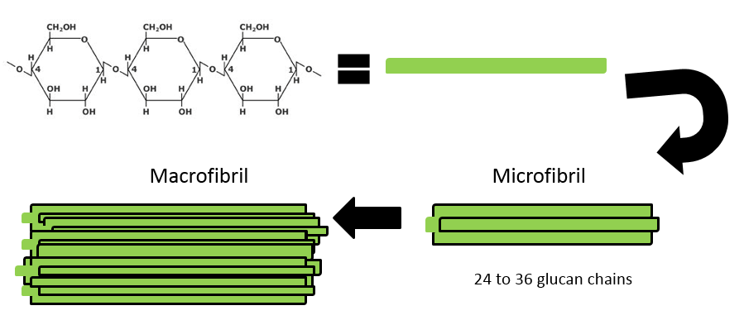
Notes:
Taking a closer look at the individual components of lignocellulose, then let’s start with the most abundant one – cellulose

Slide 7
Notes:
If we then look at the whole structure again to the organization, now notice that the cellulose forms these bundels, with the hemicellulose wowen around and the lignin as an outer layer that covers the fibrous structure and acts both as a glue but also prevents microbial attacks and UV attacks to the cellulose.

Slide 8
Lignin
Cellulose
Hemicellulose
Lignin peroxidases
Manganese peroxidases
Versatile peroxidases
Laccases
Endo-glucanases
Cellobiohydrolases
β-glucosidases
Lytic Polysaccharide Monooxygenases
Endo-xylanases
Endo-mannanases
Endo-glucanases
β-xylosidases
β-mannosidases
α-L-arabinofuranosidases
α-galactosidases
α-xylosidases
α-glucuronidases
Feruloyl esterases
Acetyl esterases

Slide 9
Heterologous gene expression in Pichia pastoris
Preparing competent cells of E. coli and P. pastoris
Transformation of E. coli and P. pastoris competent cells
Plasmid extraction and purification
DNA quantification
In silico genome mining
CUPP analysis (Conserved Unique Peptide Patterns)*
Synthetic gene constructs
Bioinformatics
(find candidate genes)
Expression in Pichia pastoris
Protein purification
Enzyme characterization
Protein concentration
Buffer exchange (diafiltration)
Protein purification (size exclusion and ion exchange chromatography)
Electrophoresis
Protein quantification
Enzyme assays
Substrate screening
Enzyme kinetics (K_{M}, V_{max}, K_{cat})
Optimum pH and temperature, thermostability
Analytical techniques: UV-VIS spectrophotometry, HPAEC-PAD, LC-MS and MALDI-TOF analysis
*Barrett & Lange, 2019 Biotechnol Biofuels 12, 102
9

Slide 10
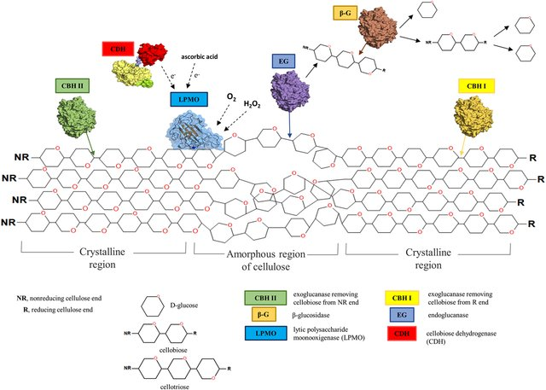

Slide 11
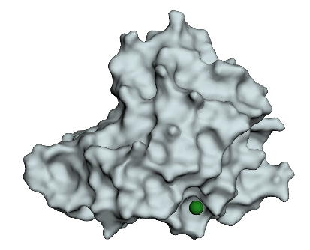
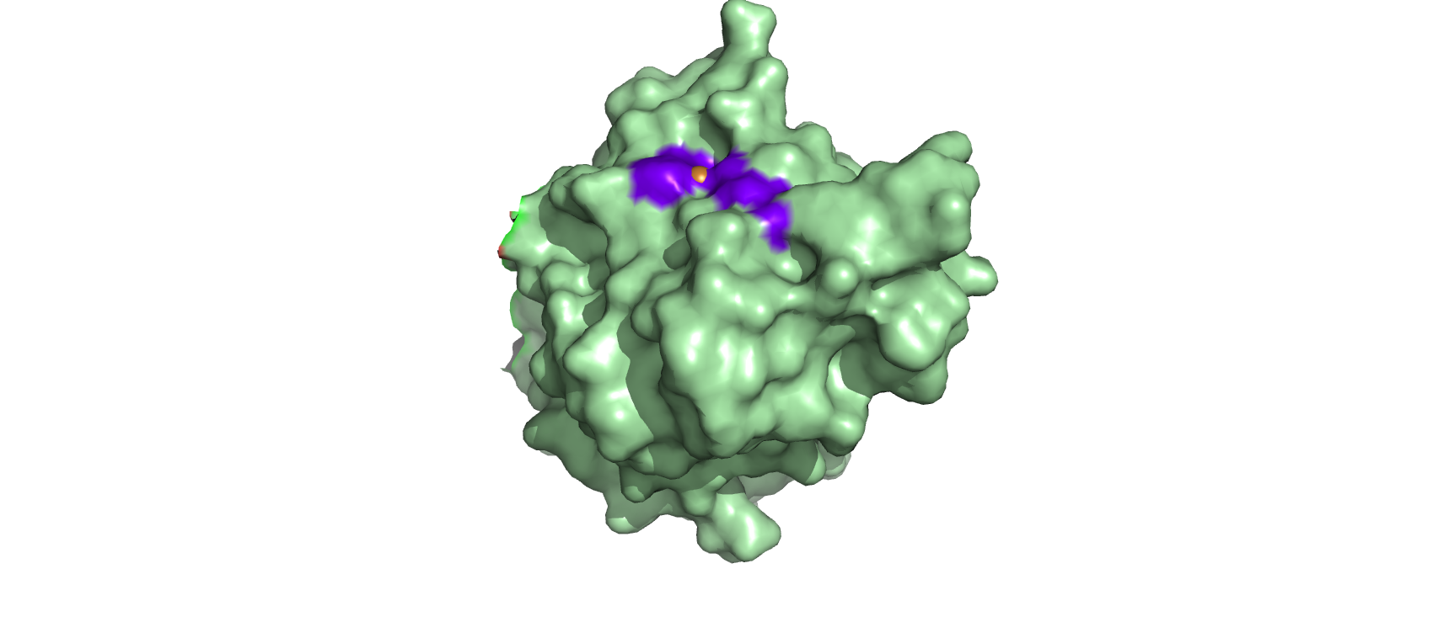
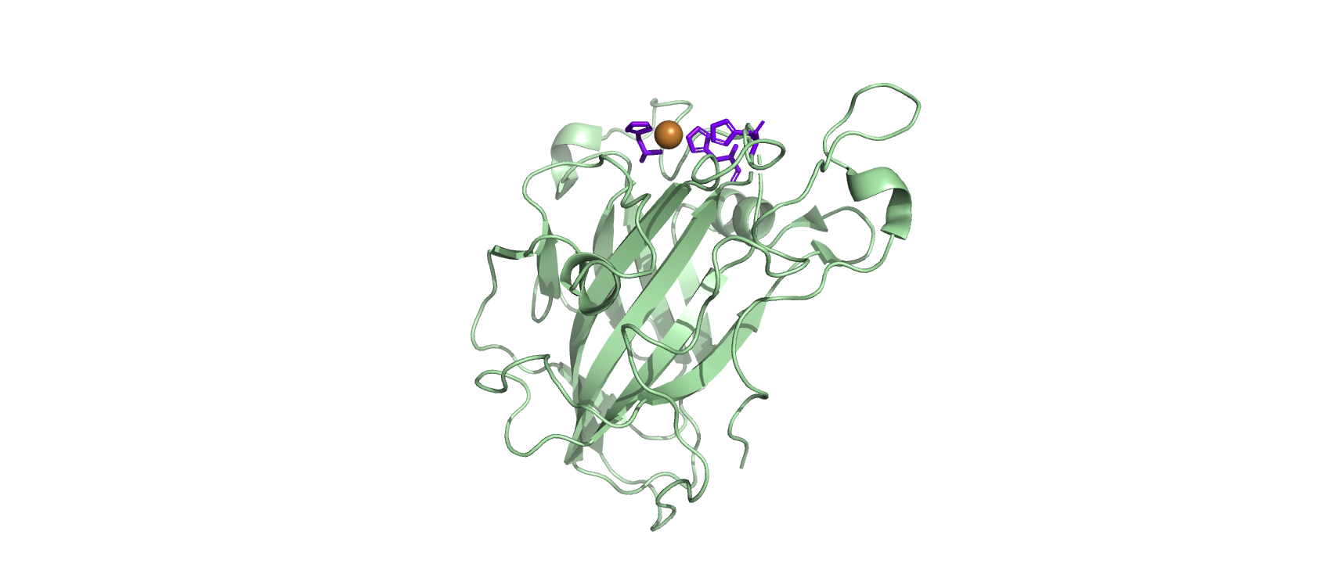
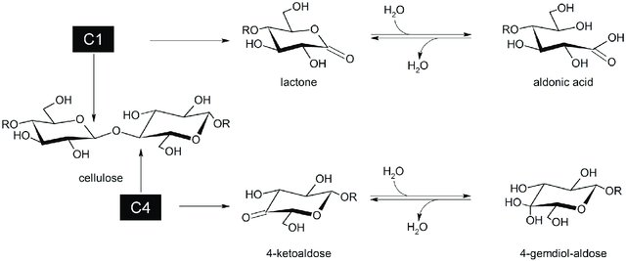
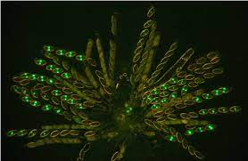
Lytic Polysaccharide Monooxygenases (LPMOs)
H₂O
H₂O₂
Regioselectivity
LPMO9C, Neurospora crassa PDB: 4D7U
Borisova et al., 2015 J Biol Chem 209, 22955
Danneels et al., 2017 PLoS One 12, 5

Slide 12
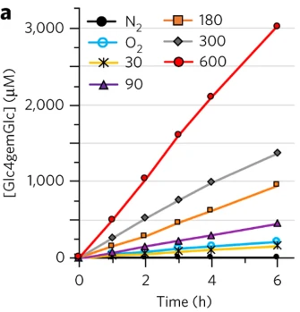
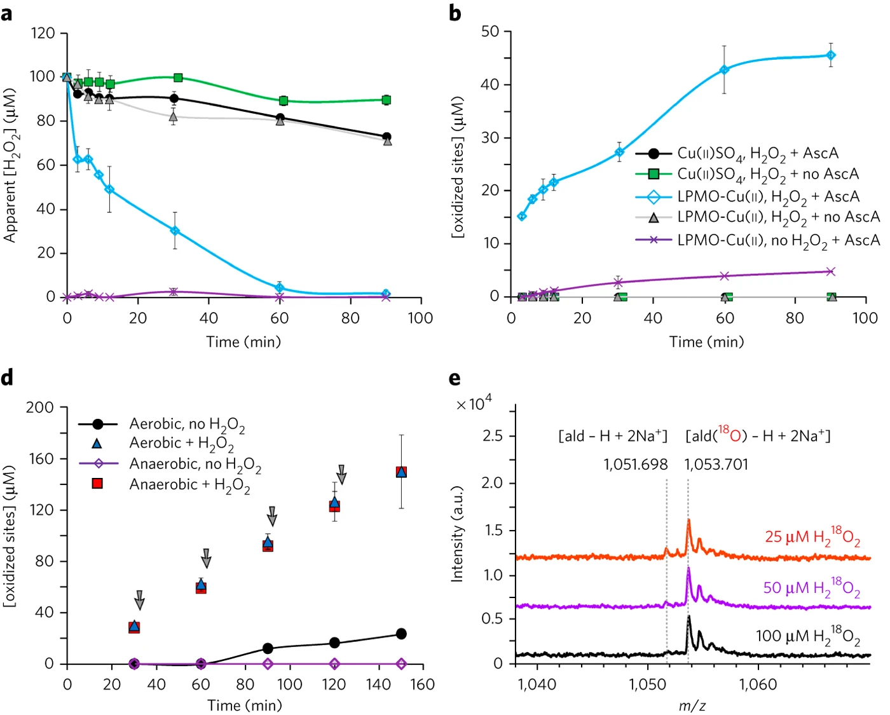
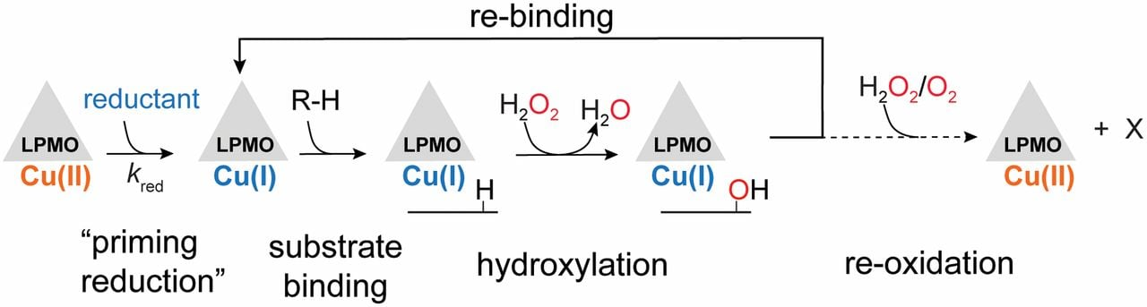
LPMOs run on H₂O₂
Bissaro et al., 2017 Nat Chem Biol, 13, 1123-28
Bissaro et al., 2019 PNAS, 117 (3), 1504-1513
Notes:
Until about 5 years ago, it was still quite enigmatic how the LPMO was fuelled. Where did the electrons come from? In the lab, we would supply electrons via an reducing agent, typically ascorbic acid. But the reactions were slow, and the enzymes die quickly in the presences of aa. At the same time, the continued question was – where does the ascorbic acid come from in Nature??
After quite some speculations it became clear that LPMOs use H2O2 as a co-substrate. This the convincing work of some of previous co-workers in Norway, that clearly shows that hydrogen peroxide is an important player in the reaction.
This plot in particular shows how the reaction runs with the exogeneous addition of H2O2 compared to the reaction with AA.
So all in all, a new possible mechanism for LPMO-reactions were proposed, which consists of an initial priming reaction, where the Cu is activated to the reactive Cu-I state. Hereafter, the enzyme binds the substrate and H2O2 hydroxylates the substrate.

Slide 13
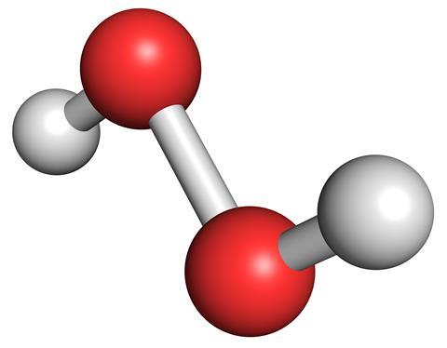
Where does H₂O₂ come from?

Slide 14
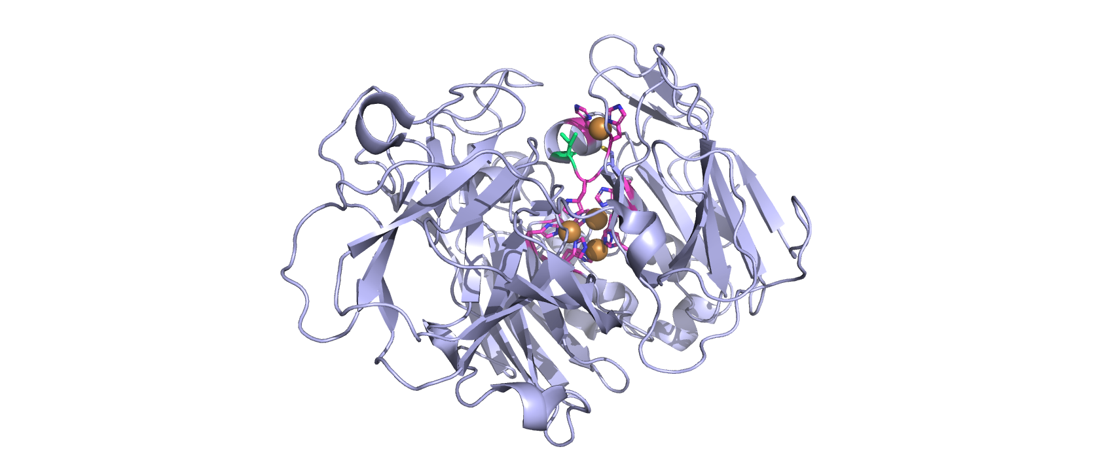
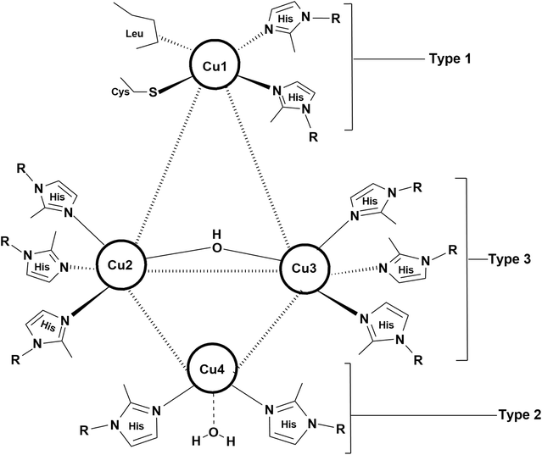
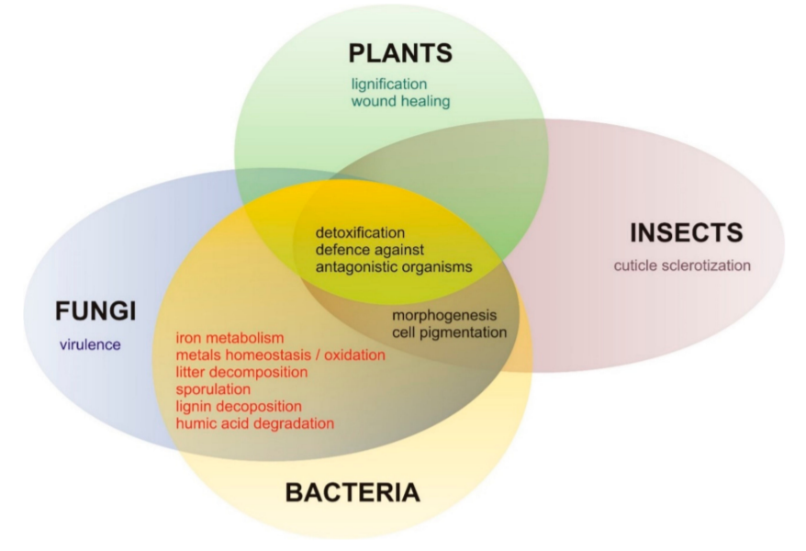
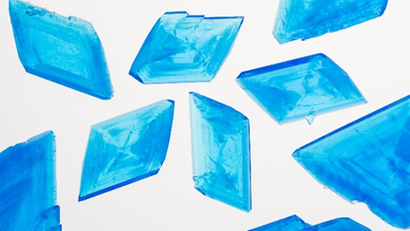

Laccases
2H5U
Discovered in 1883
Blue enzymes: tri-nuclear copper site
Janusz et al., 2020 Int J Mol Sci, 21, 966

Slide 15
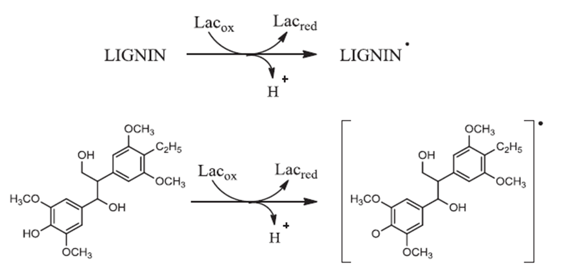
MCO – Multi Copper Oxidase
Enzyme catalysis
4
4 H⁺
4
2 H₂O
O₂
… hereafter pure chemistry
Munk et al., 2015 Biotechnol Adv, 33 (1), 13-24
15

Slide 16
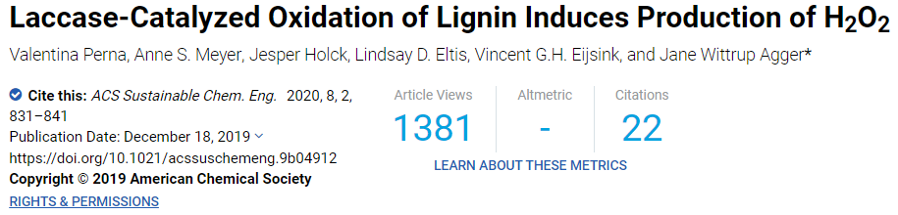
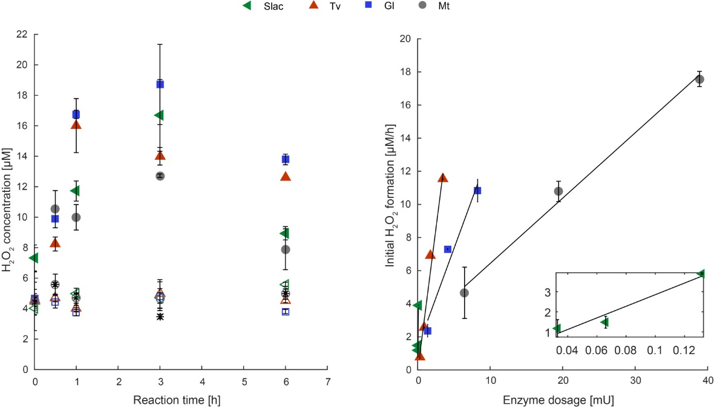
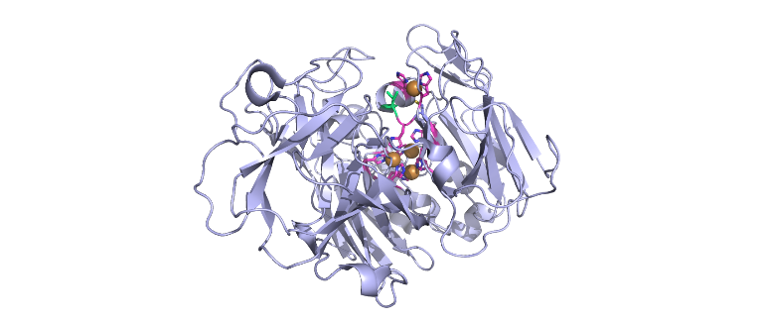
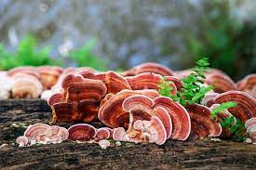
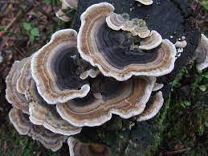
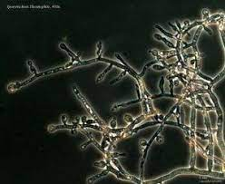
Perna et al., 2020 ACS Sus Chem Eng, 8 (2), 831-841

Slide 17
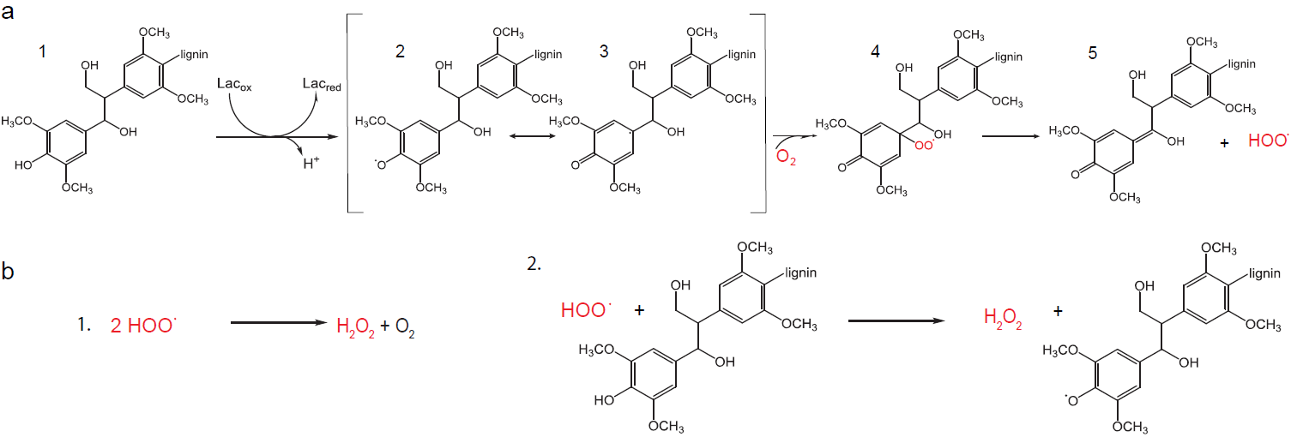
Possible H₂O₂ formation
Perna et al., 2020 ACS Sus Chem Eng, 8 (2), 831-841
17

Slide 18
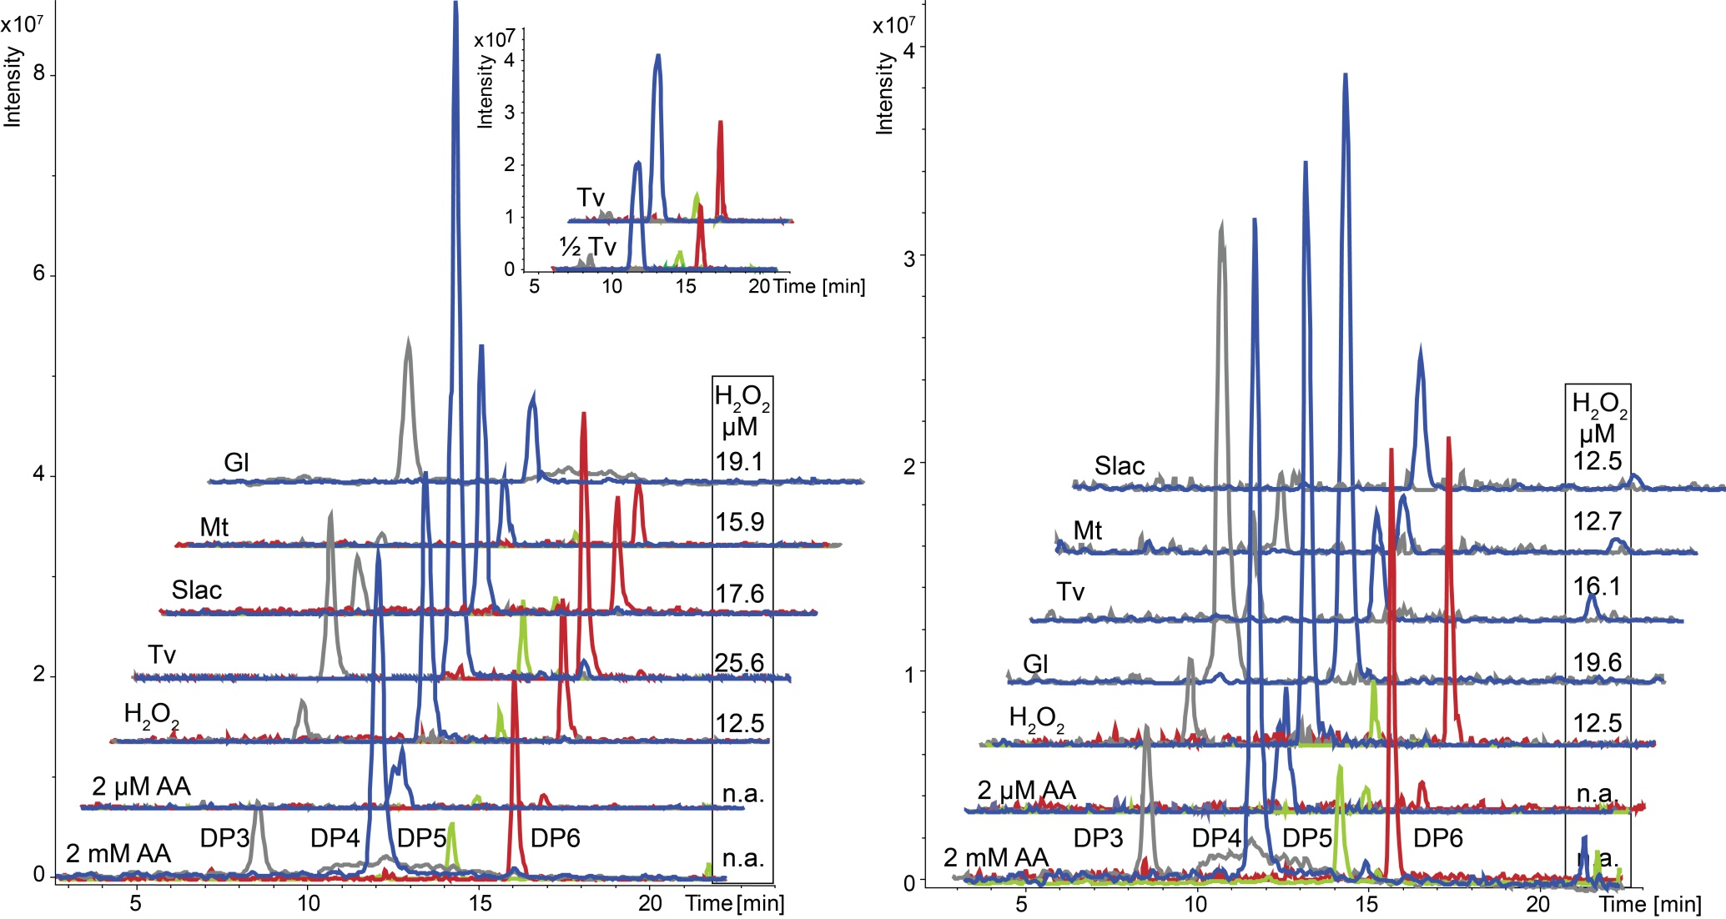
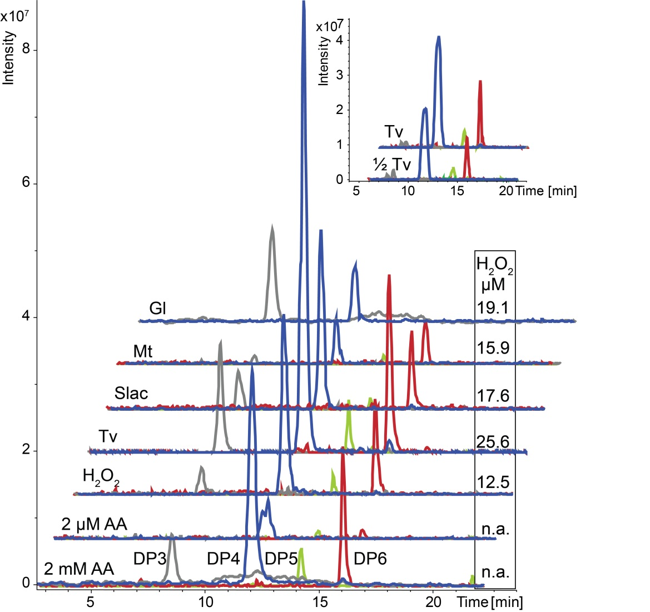

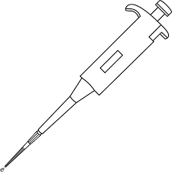
LPMO fuelling by laccase oxidation of lignin
Organosolv lignin
Birch wood
Laccase + lignin
Formation of H₂O₂
LPMO + cellulose
Formation of cello-ox
18

Slide 19
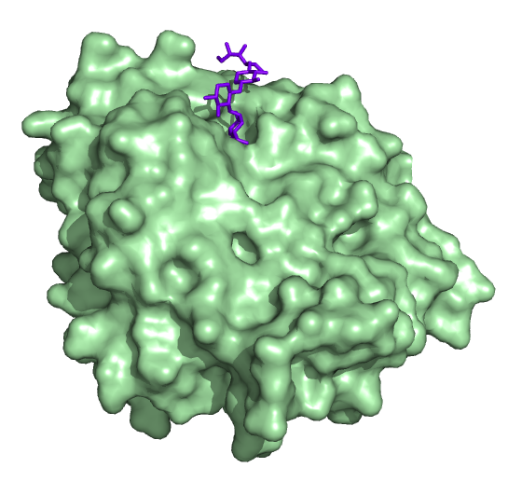
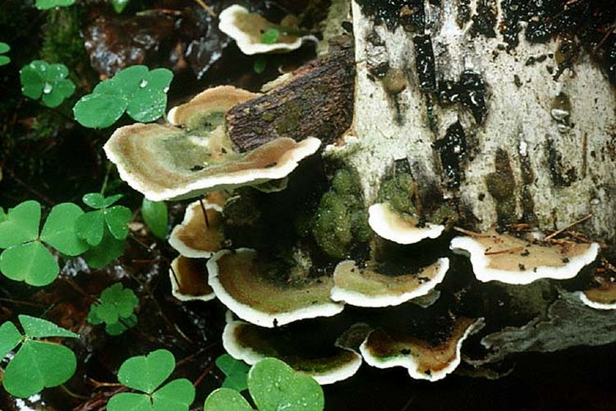
Lignin-Carbohydrate Complexes (LCCs)
α/β-hydrolases
Ser-His-Glu - catalytic triad
Surface exposed active site
Preference for 4-O-methylation, bulky alcohols, α-glucuronoyls and γ-esters
CE15 Glucuronoyl esterase

Slide 20
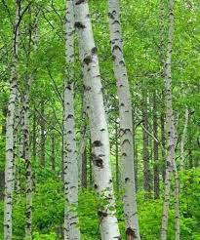
Ester linked LCCs
20

Slide 21
Organosolv fractionation of birchwood
~ 1.5% glucuronoxylan
 | Structural arabinan | Structural 4-O-methyl-glucuronoyl | Structural glucan | Structural xylan | Lignin | Structural acetate
 | g/kg DM
LCC rich precipitate (LRP) | 0.08 ±0.02 | 2.39 ±0.3 | 0.51 ±0.1 | 11.43 ±2.3 | 902.05 ±28 | 0.81 ±0.2
Mosbech et al., 2018 Biotech Biofuels, 11:71
21
21

Slide 22
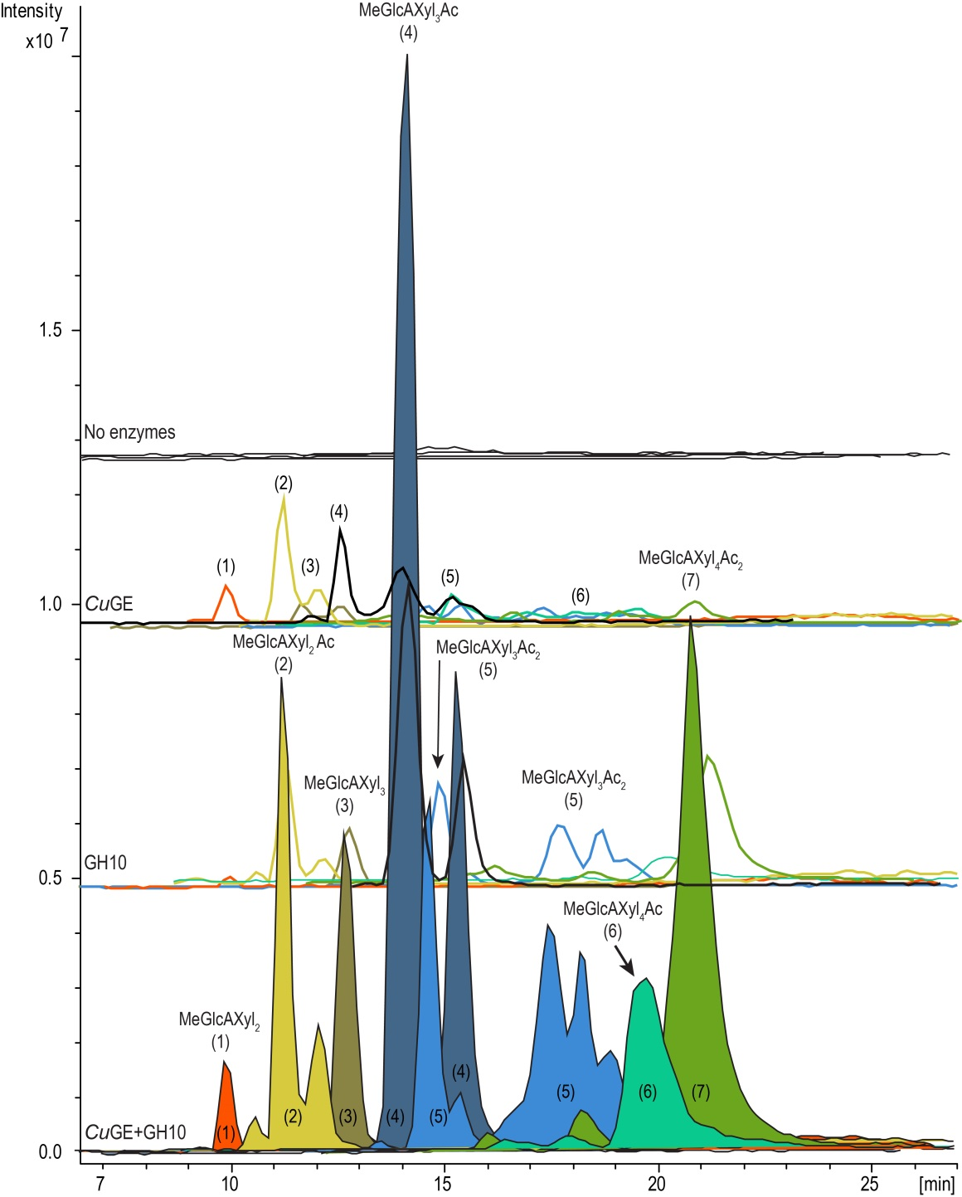
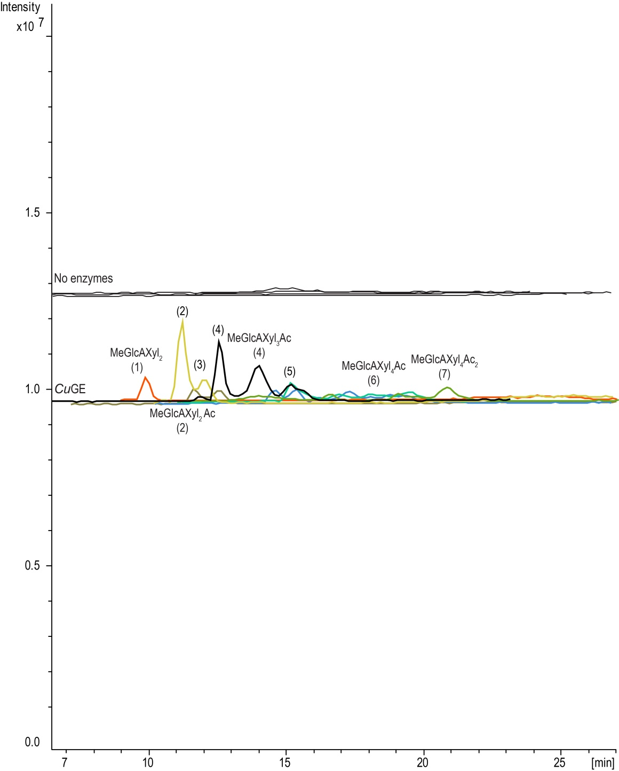
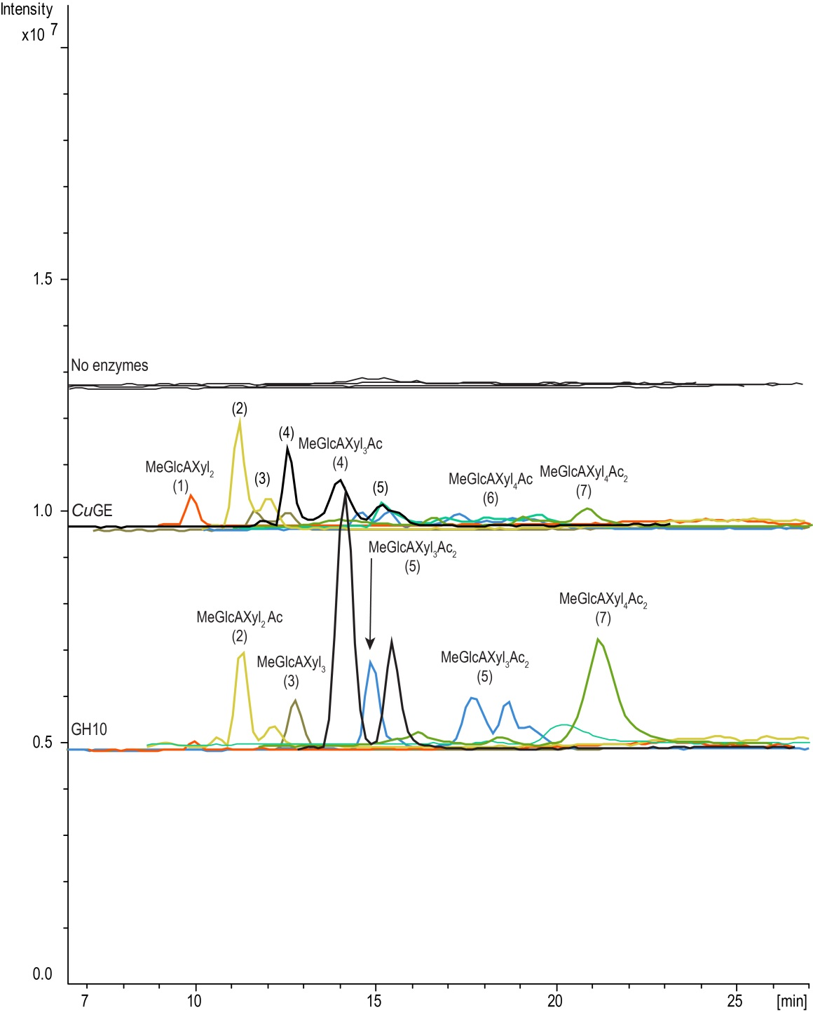
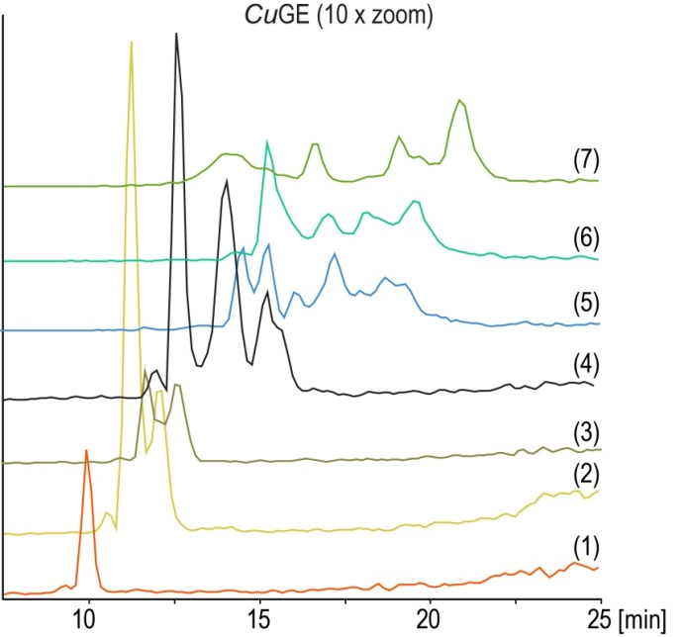
Birchwood LRP
Porous Graphitic Carbon LC-MS
CuGE polishes lignin
Carbohydrate free
n
Mosbech et al., 2018 Biotech Biofuels, 11:71
22
22

Slide 23
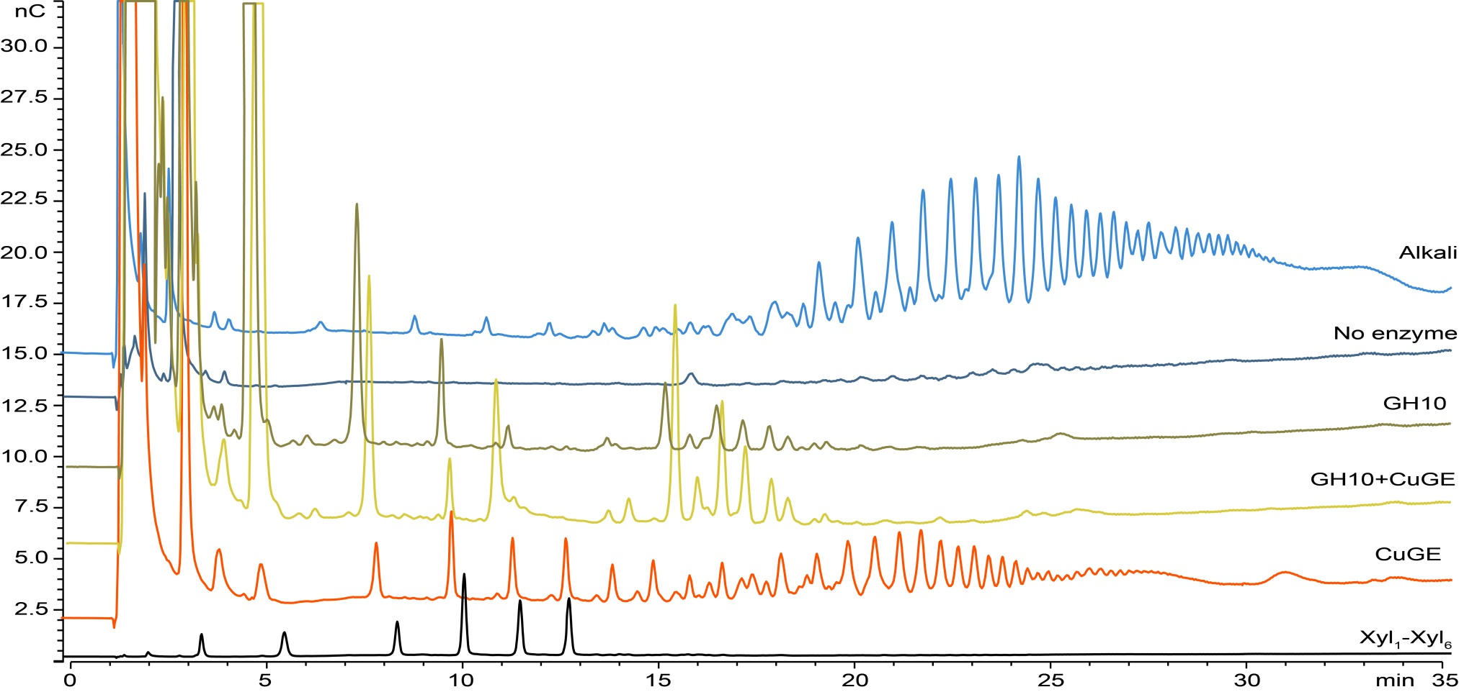
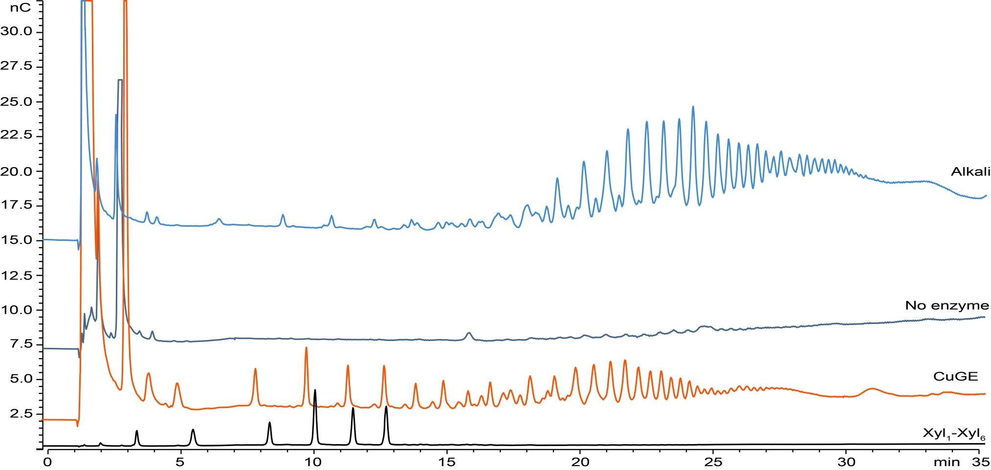
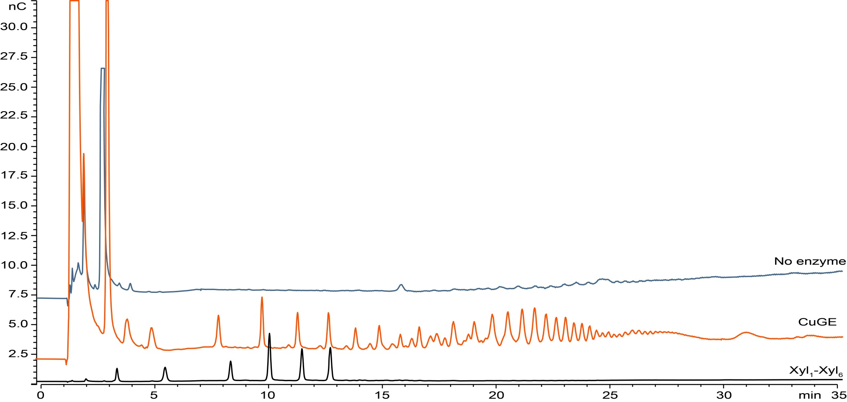
CuGE Releases Long Products
HPAEC-PAD-PA100
Mosbech et al., 2018 Biotech Biofuels, 11:71
23
23

Slide 24
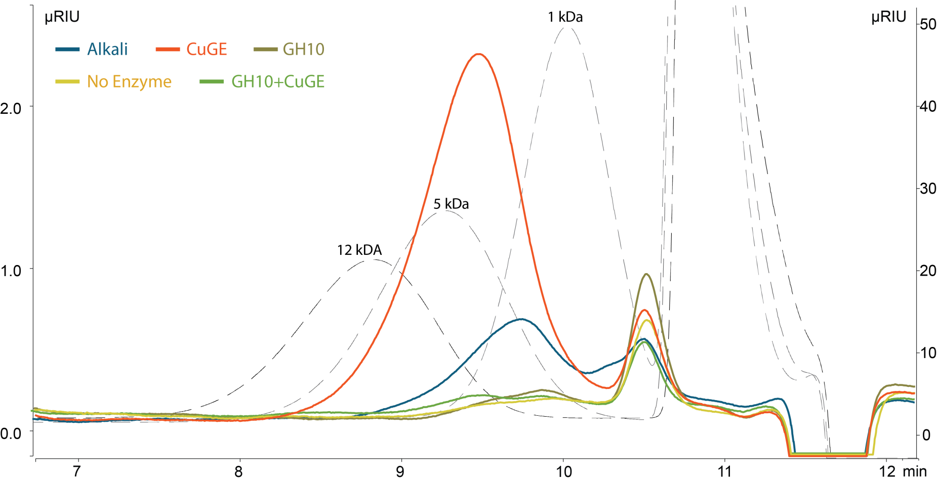
CuGE Releases Long Products
TSKgel G3000PW
Mosbech et al., 2019 App Microbiol Biotechnol,103
24
24

Slide 25
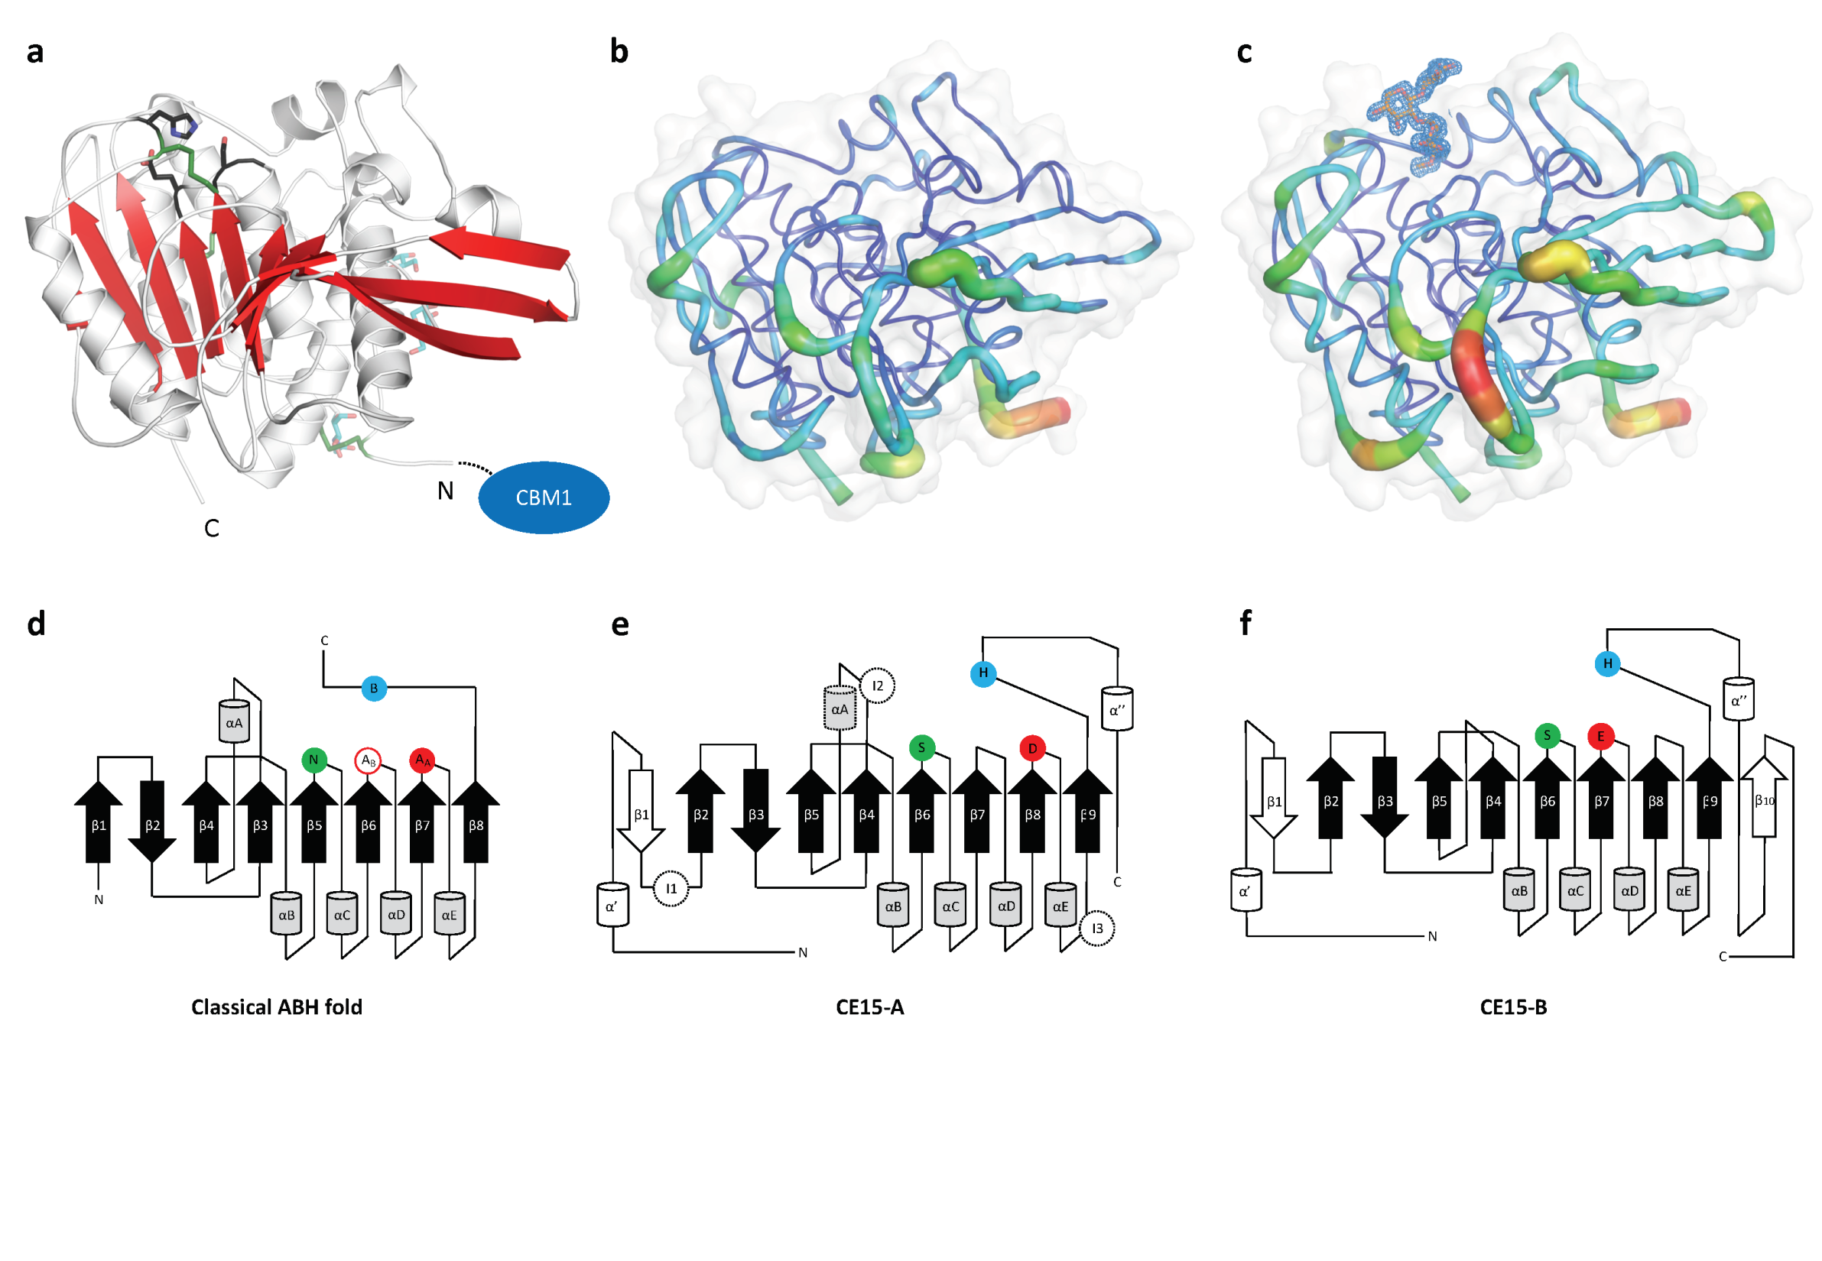
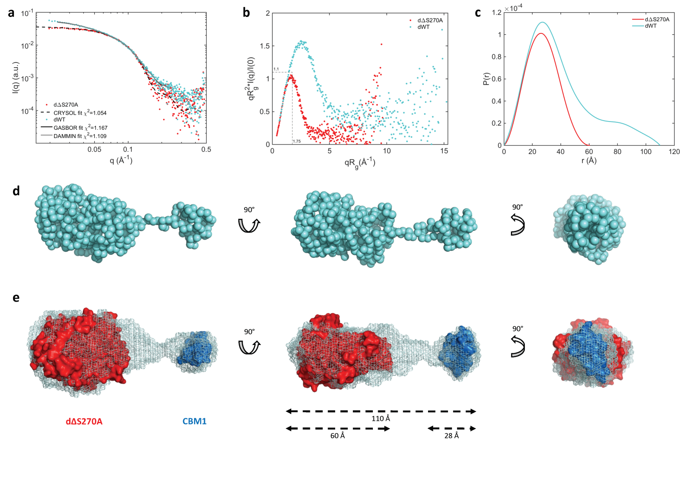
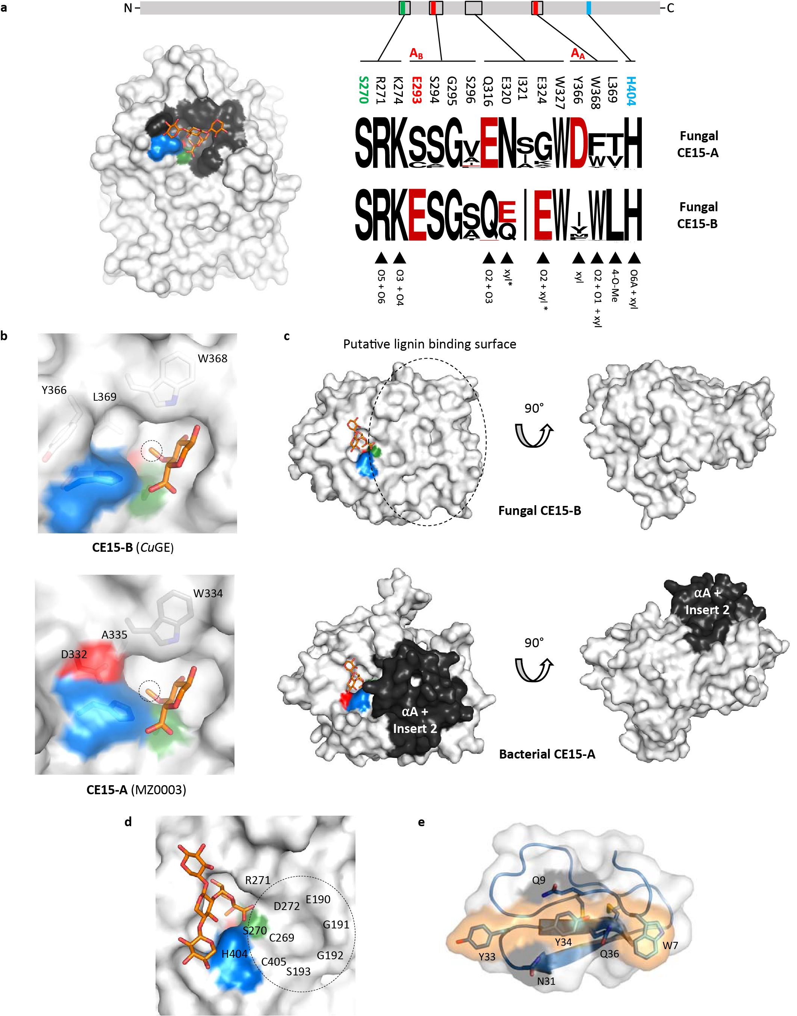
The crystal structure of CuGE
SAXS data: elongated, rigid globular structure.
Non-flexible linker
Surface-exposed active site, flat and open structure around the active site
Binding surface on CBM1 lined with aromatic residues
Ernst et al., 2020 Nat Comm,11, 1-12
25
25

Slide 26
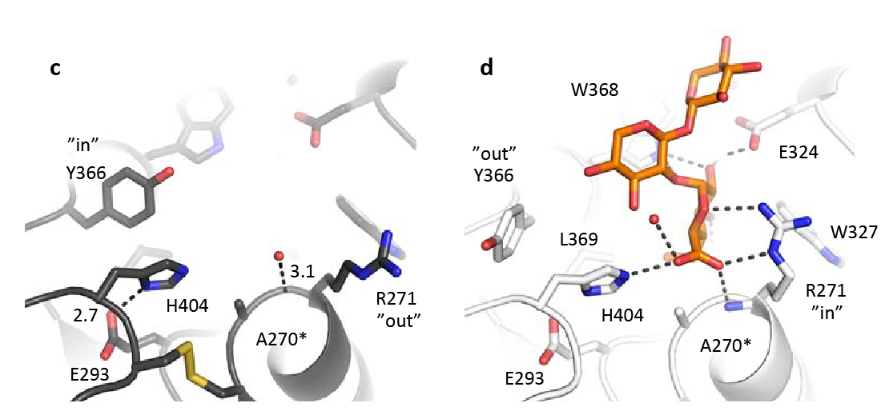
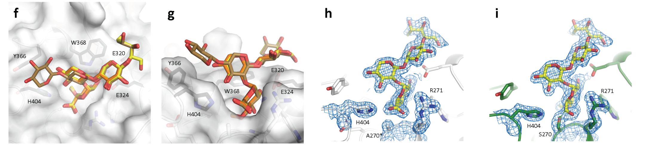
Complexes with aldouronic acids
Ligands
Reduced 4-O-methyl-triuronic acid
Reduced 4-O-methyl-tetrauronic acid
Recognition of the 4-O-methylation of the glucuronoyl substitution
Xylan backbone has little interaction and much space
Active enzyme forms the covalent acyl-enzyme intermediate
Ernst et al., 2020 Nat Comm,11, 1-12
26
26

Slide 27
Enzyme diversity
Mosbech et al., 2019 App Microbiol Biotechnol,103
Ernst et al., 2020 Nat Comm,11, 1-12
27

Slide 28
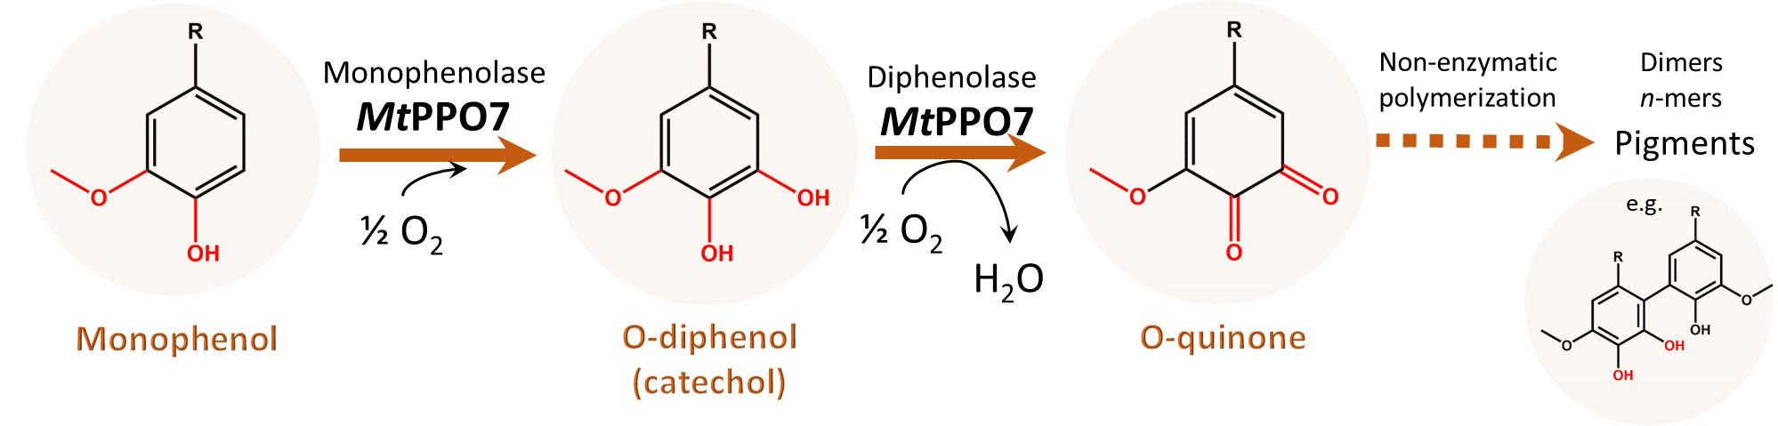
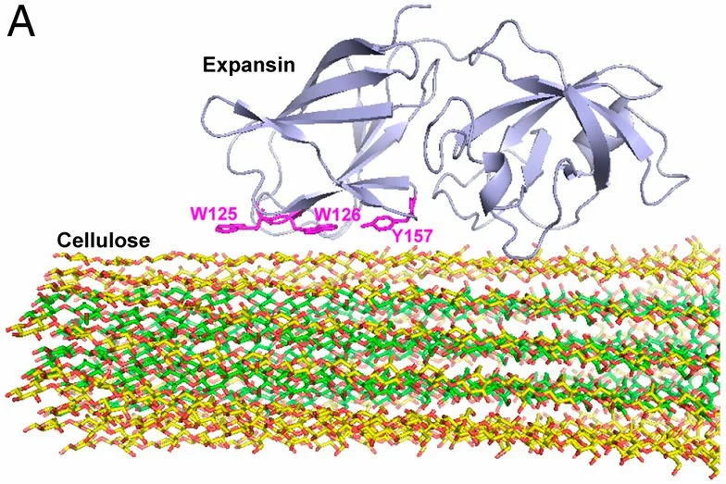

New enzymes to pursue…
Polyphenol oxidases (related to tyrosinases)
Expansins (non-catalytic)
Unspecific peroxygenases (H₂O₂ dependent, related to cytochrome P450)

Slide 29







Acknowledgements
Prof. Anne Meyer
Senior Researcher Jesper Holck
Post Doc Line Munk
Post Doc Valentina Perna
Post Doc Kristian Barrett
Post Doc Caio
Caroline Mosbech, PhD Novozymes A/S
Heidi Asschenfeldt Ernst, PhD Agilent Technologies
Prof. Sine Larsen
Associate Prof. Annette Eva Langkilde
Assoc. Prof. Bjørge Westereng
Prof. Vincent Eijsink
Prof. Finn L. Aachmann
Post Doc Leesa Klau
Funding
Novo Nordisk Foundation
Bio-Value Strategic Platform for Innovation and Research
Independent Research Fund Denmark
Prof. Lindsay Eltis
29
29

